Slide 1

Project Management Concepts

Slide 2
Chapter Concepts
Definition of a project and its attributes
Key constraints within which a project must be managed
Life cycle of a project
Definition of project management
Elements of the project management process
Identification and engagement of stakeholders
Implications of global project management
Project Management Institute
Benefits of project management

Slide 3
Learning Outcomes
Define what a project is
List and discuss the attributes of a project
Explain what is meant by project objective
Define what is meant by project deliverable
Provide examples of projects
Discuss project constraints
Describe the phases of the project life cycle
Define and apply Project Management
Discuss the steps of the planning process
Identify the three elements of the executing process
Create a stakeholder register
Discuss stakeholder engagement
Discuss some implications of global project management
Discuss the Project Management Institute
List benefits of project management techniques

Slide 4
Project Integration Management
Project Management Knowledge Areas from PMBOK® Guide

Slide 5
Project Attributes
Clear objective
Series of interdependent activities
Various resources
Specific time frame
Unique, one-time endeavour
Sponsor or customer
Degree of uncertainty

Slide 6
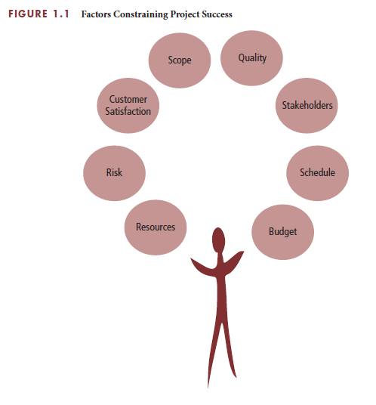
Balancing Project Constraints

Slide 7
Project Manager Actions
Prevent, anticipate, overcome
Have good planning and communication
Be responsible

Slide 8
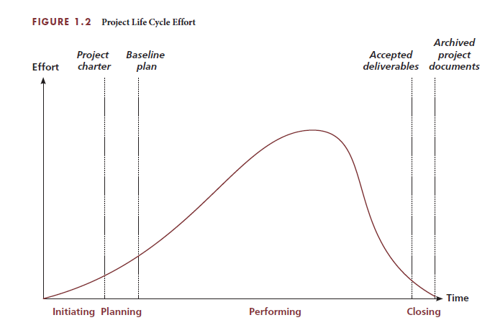
The Project Life Cycle

Slide 9
Initiating phase
First phase
Identify need, problem, or opportunity
Determine if select project
Develop project charter
Rationale
Project objective
Expected benefits
General requirements and conditions
Decide if RFP needed

Slide 10
Planning phase
Second phase
Show how project scope will be achieved
Plan the work and work the plan
Develop baseline plan
What needs to be done – scope, deliverable
How it will get done – activities, sequence
Who will do it – resources, responsibilities
How long it will take – durations, schedule
How much it will cost – budget
What the risks are
Have actual resources plan the work

Slide 11
Performing phase
Third phase
Achieve project objectives
Project manager leads
Project team completes the project
Increase pace as more resources are added
Monitor and control progress
Take corrective action as needed
Manage and control changes with sponsor approval
Achieve customer satisfaction with acceptance of deliverable

Slide 12
Closing phase
Final phase
Collect and make final payments
Recognise and evaluate staff
Conduct post project evaluation
Document lessons learned
Archive project documents
Record lessons learned

Slide 13
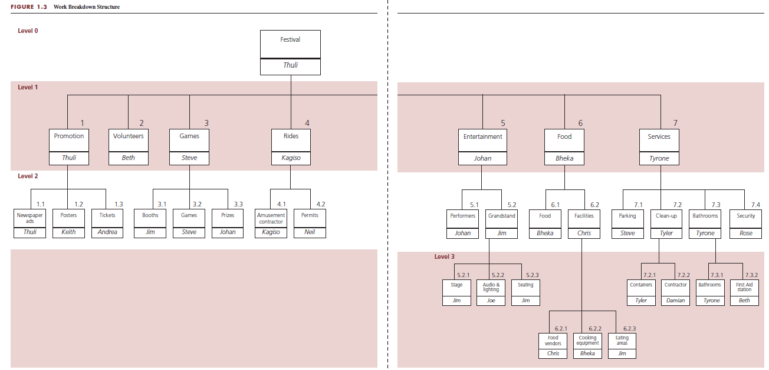
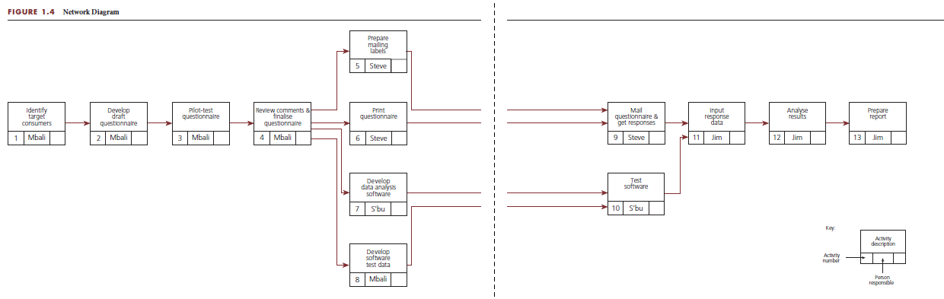
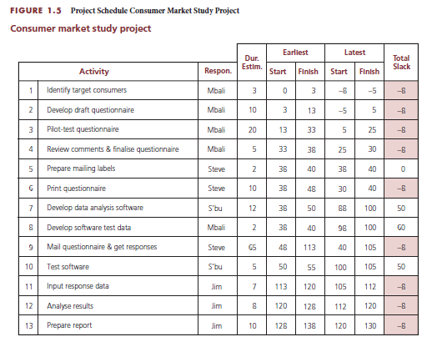
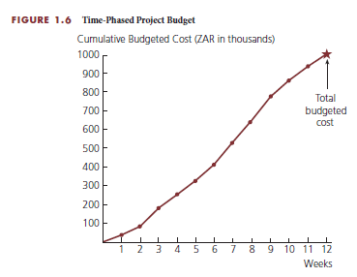
Project Planning Process
Establish project objective
Define scope
Create WBS
Assign responsibility
Define specific activities
Sequence activities
Estimate activity resources
Estimate activity durations
Develop project schedule
Estimate activity costs
Determine budget

Slide 14
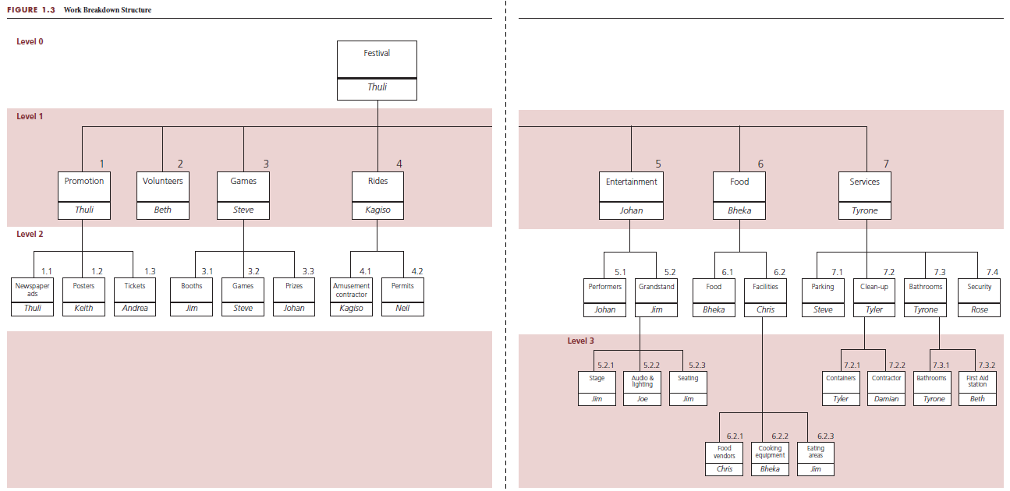
Create WBS and assign responsibility

Slide 15
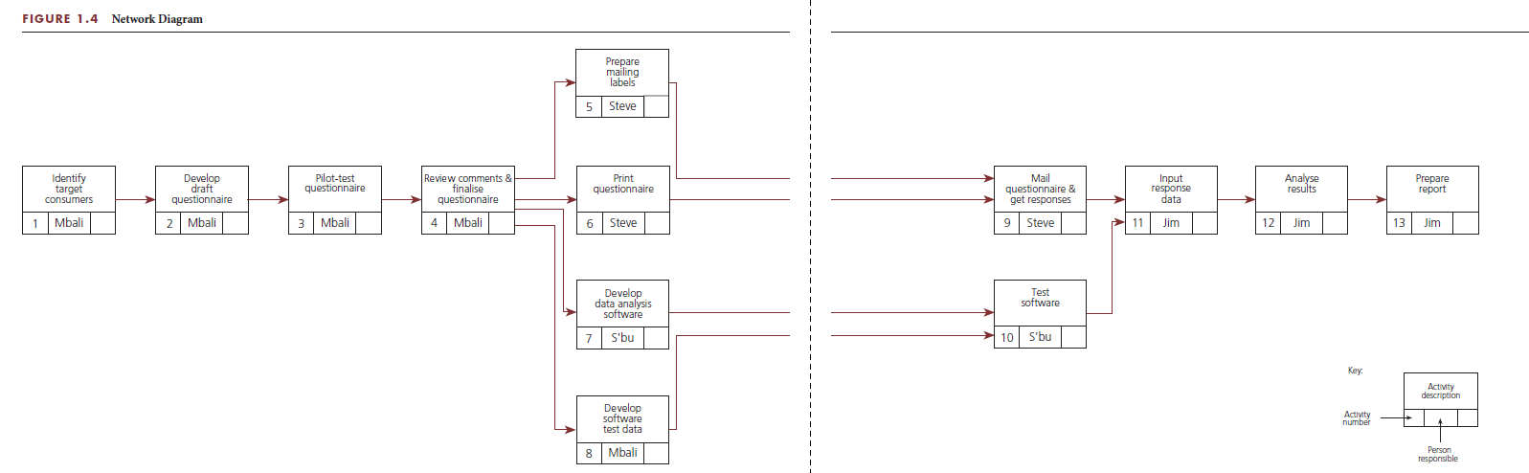
Sequence activities

Slide 16
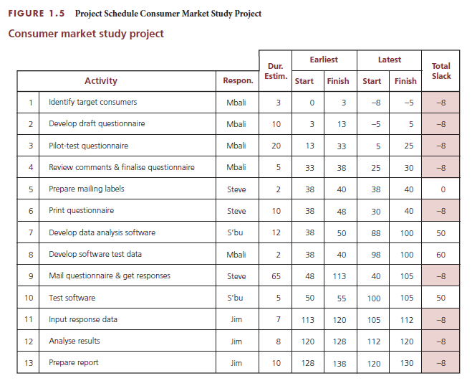
Develop the project schedule

Slide 17
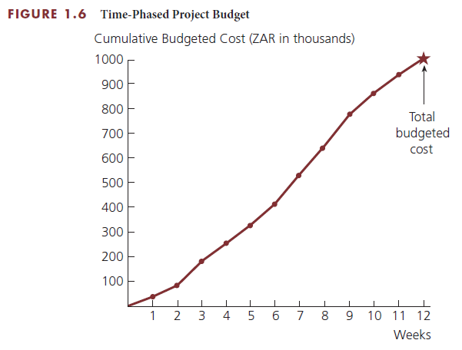
Determine budget

Slide 18
Execute the project plan
Perform the work
Monitor and control progress
Control changes

Slide 19
Stakeholder Engagement
Who are stakeholders?
What to create
Customer/sponsor
Project team including subcontractors and suppliers
organisations or groups
Supportive or adversarial
Want to be kept informed because of potential impact
Stakeholder register
Created as identify stakeholders
Include
Key contact information
Role or specific topics of interest
Expectations
Any known issues
Areas of potential influence
Issue log

Slide 20
Global Project Management
Globalisation
Helpful competencies
Adds a dimension of complexity
Changes project dynamics
Requires awareness of factors
Cultural differences
Currency
Codes and regulations
Business organisation
Political relations
Workforce availability
Foreign language skills
Knowledge of
Cultures
Geography
World history and contemporary events
International economics
Awareness of
Customs and etiquette
Geopolitical environment
Technology adoption and translation software

Slide 21
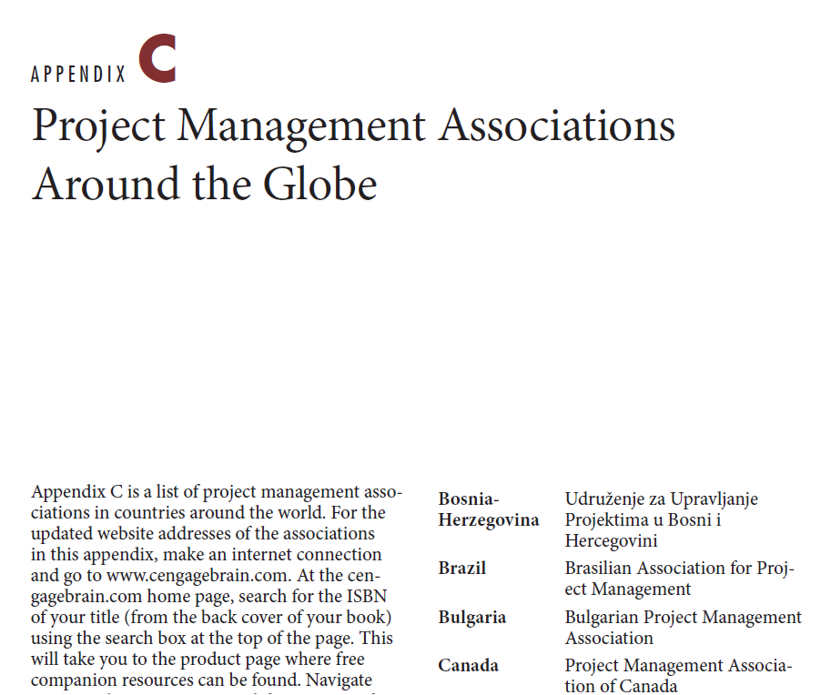
Project Management Associations
Project Management Institute
Global associations
Worldwide non-profit association of practitioners
~500 000 members in nearly 200 countries
~270 chapters in >80 countries
>30 online communities for collaboration
PMBOK® Guide
PMI Code of Ethics and Professional Conduct
Certifications
www.pmi.org
Links available at www.cengagebrain.com

Slide 22
Critical Success Factors
Planning and communication are critical to successful project management. They prevent problems from occurring or minimise their impact on the achievement of the project objective when they do occur.
Taking the time to develop a well thought-out plan before the start of the project is critical to the successful achievement of any project.
A project must have a clear objective of what is to be achieved and defined in terms of end product or deliverable, schedule, and budget; and is agreed upon by the customer.
Involve the sponsor or customer as a partner in the successful outcome of the project through active participation during the project.
Achieving customer satisfaction requires ongoing communication with the customer to keep the customer informed and to determine whether expectations have changed.
The key to effective project control is measuring actual progress and comparing it to planned progress on a timely and regular basis and taking any needed corrective action immediately.
After the conclusion of a project, the project performance should be evaluated to learn what could be improved if a similar project were to be undertaken in the future. Feedback should be obtained from the sponsor or customer and the project team.
Learning and understanding the culture and customs of other project participants will demonstrate respect, help build trust, and aid in developing an effective project team; and it is critical for successful global project management.

Slide 23
Summary
A project is an endeavour to achieve a specific objective through a unique set of interrelated activities and the effective utilisation of resources.
The successful achievement of the project objective could be constrained by many factors, including scope, quality, schedule, budget, resources, risks, customer satisfaction, and stakeholder support.
The project life cycle has four phases: initiating, planning, performing, and closing the project.
Project management is planning, organising, coordinating, leading, and controlling resources to achieve the project objective. The project management process involves two major functions: first establishing a plan and then executing that plan to achieve the project objective.
Globalisation changes the dynamics of a project and adds a layer of complexity that can adversely affect the project outcome if the project participants are not aware of what they can encounter regarding cultural differences and multinational economic transactions.
The Project Management Institute is a premier worldwide non-profit association for practitioners in the project management profession.
The ultimate benefit of implementing project management techniques is having a satisfied customer – whether you are the customer of your own project or a business (contractor) being paid by a customer to perform a project.

